Slide 1
Mask RCNN
Alex, 2020.06.15
Mask R-CNN

Slide 2
Outline
What is Instance Segmentation ?
Introduction to Mask RCNN
R-CNN -> Fast R-CNN -> Faster R-CNN
Mask RCNN - ROS Align
Summary

Slide 3
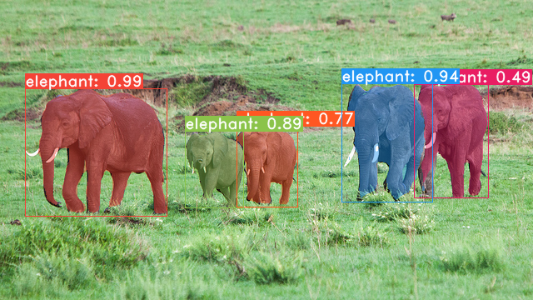
What is Instance Segmentation ?
Target detection = category + location (faster-RCNN)
Semantic segmentation = object contour (FCN)
Instance segmentation = category + location + object contour (Mask-RCNN)

Slide 4
Introduction to Mask RCNN(2017)
Mask RCNN is improved on the basis of faster-RCNN
Can complete a variety of tasks such as classification, detection, semantic segmentation, instance segmentation, human pose recognition, etc.
The three challenges of the COCO dataset : instance segmentation, bounding-box object detecton, and person keypoint detection are all better than the existing single-model algorithm.
Mask RCNN = Faster-RCNN + FCN

Slide 5
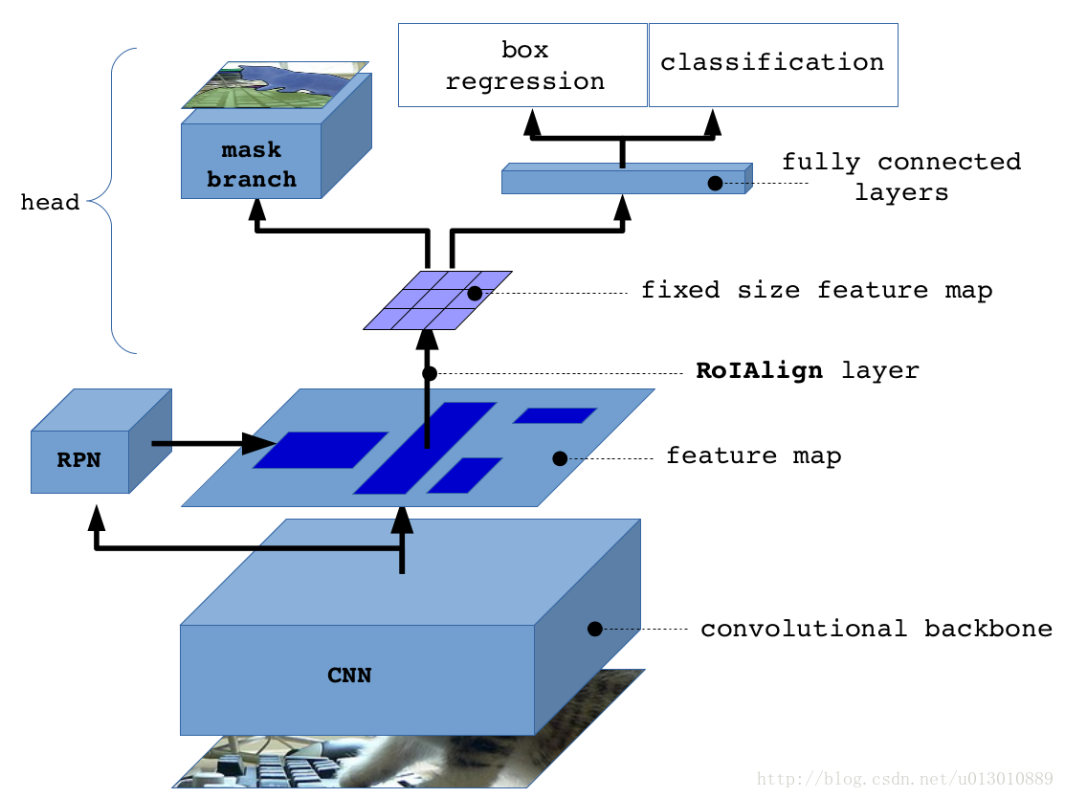
Introduction to Mask RCNN

Slide 6
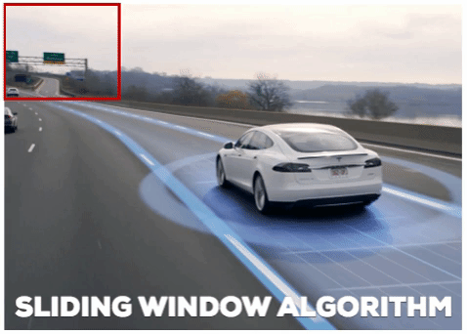
Sliding Windows Detector
It cost too much time !!!

Slide 7
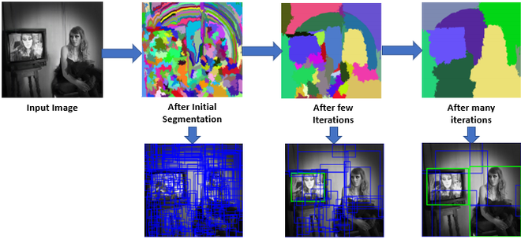
RCNN - Selective Search
Regions of interest (ROI)
Notes:
相似的像素 - 顏色、紋理

Slide 8
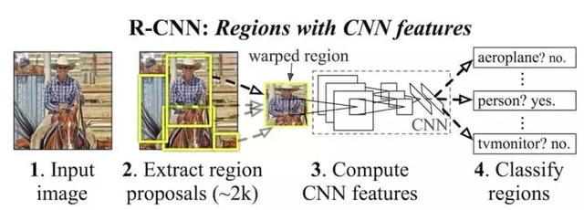
RCNN
Region proposal : selective search (ROIs)
Bounding box and classification
Notes:
很多重疊區域
計算量大時間久

Slide 9
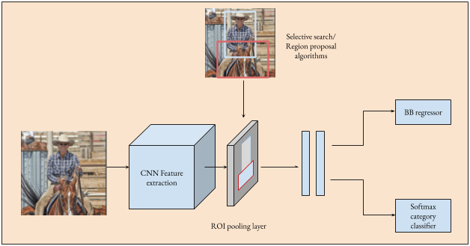
Fast R-CNN
Region proposal from feature maps instead of input images.
Warp the patches to a fixd size using ROS pooling.
Notes:
RCNN 20s

Slide 10
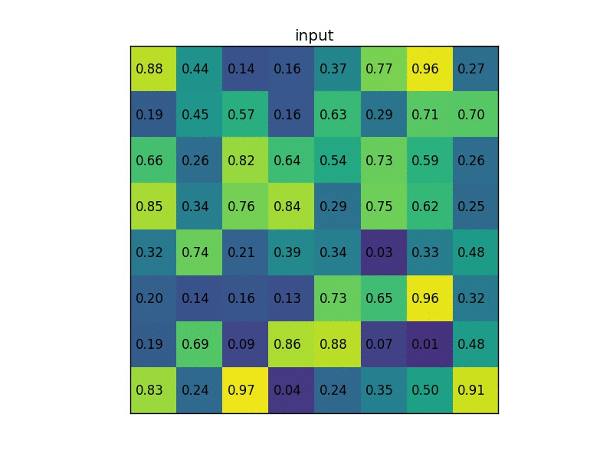
ROI Pooling
The process of RoI Pooling is to map the rectangular boxes of different sizes into rectangular boxes of fixed size (w * h);

Slide 11
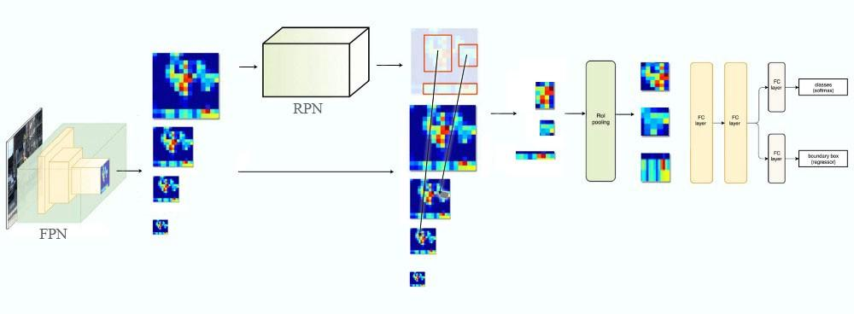
Faster R-CNN
Get region proposals by region proposal network(RPN)

Slide 12
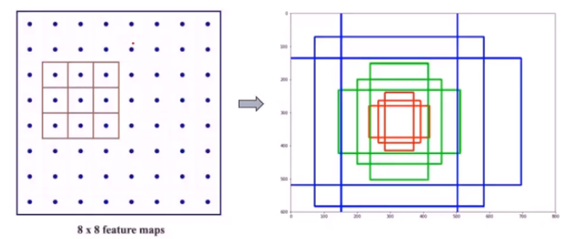
Anchor
Prediction : For each location in feature maps, RPN make k guess.
Training : Which object is the anchor responsible for?
According to IOU.
9 anchor : 3different scales at 3different aspect ratio

Slide 13
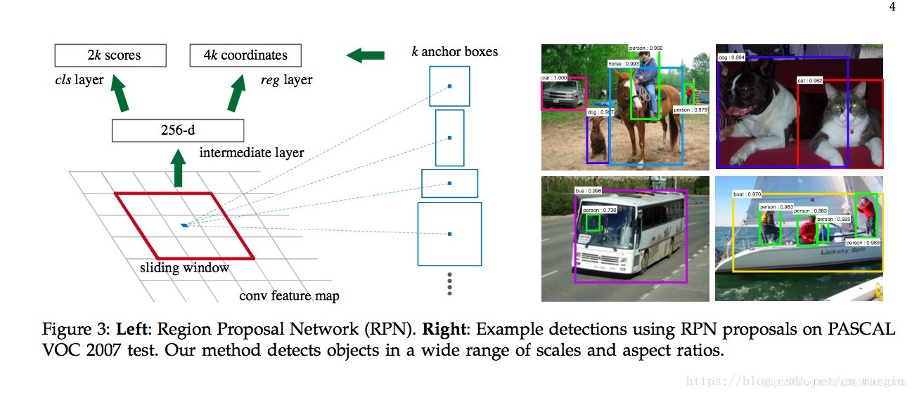
Anchor

Slide 14
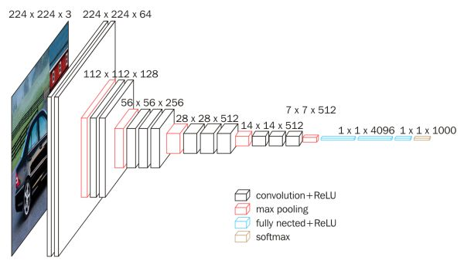
FPN
Single scale object detection. (May miss small object.)

Slide 15
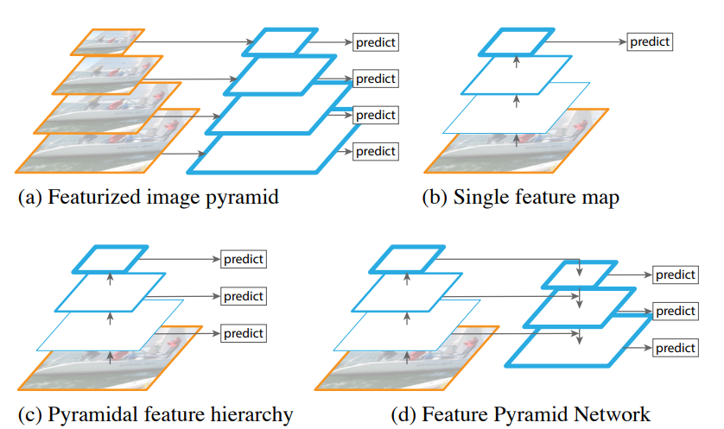
FPN
Recognizing objects at vastly different scales is important.
Faster R-CNN
SSD

Slide 16
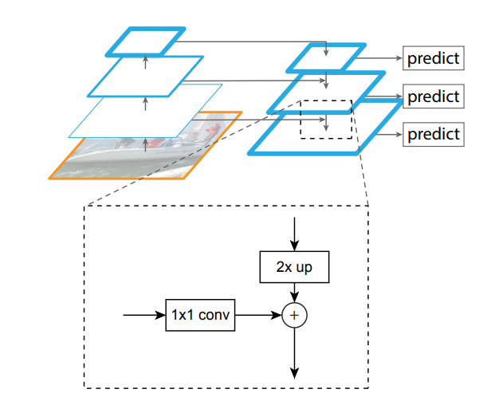
FPN
Bottom-up pathway
Top-down pathway
Lateral connections
Accurate location + High semantics

Slide 17
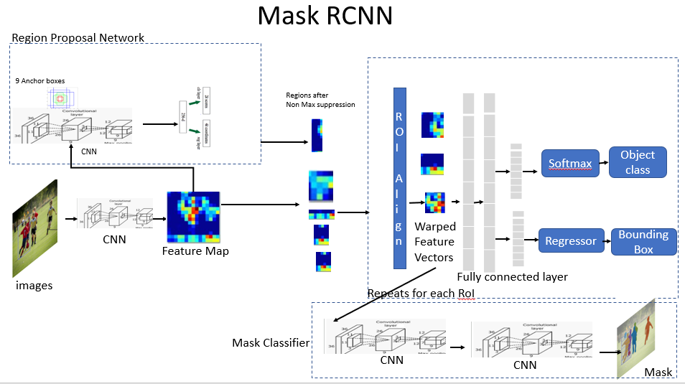
Mask RCNN

Slide 18
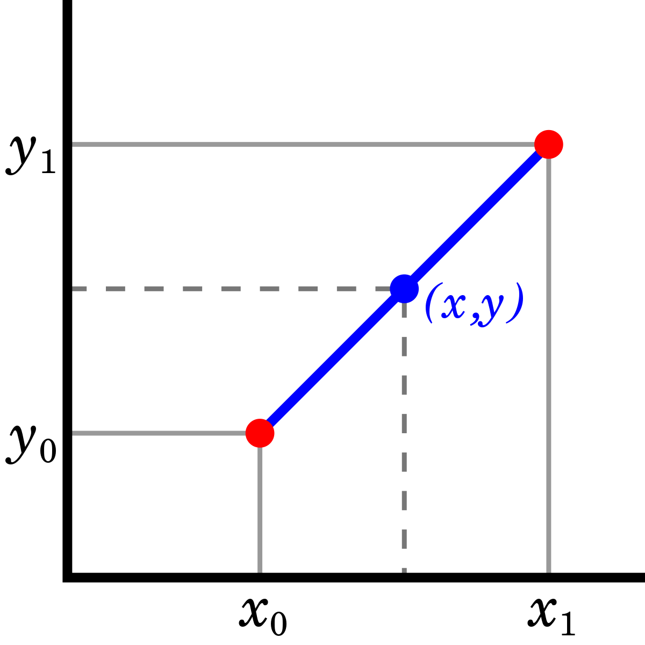
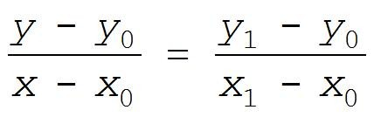
ROI-Align (Bilinear Interpolation)
linear interpolation
Notes:
前者使用了兩次量化操作，而後者並沒有採用量化操作，使用了線性插值算法

Slide 19
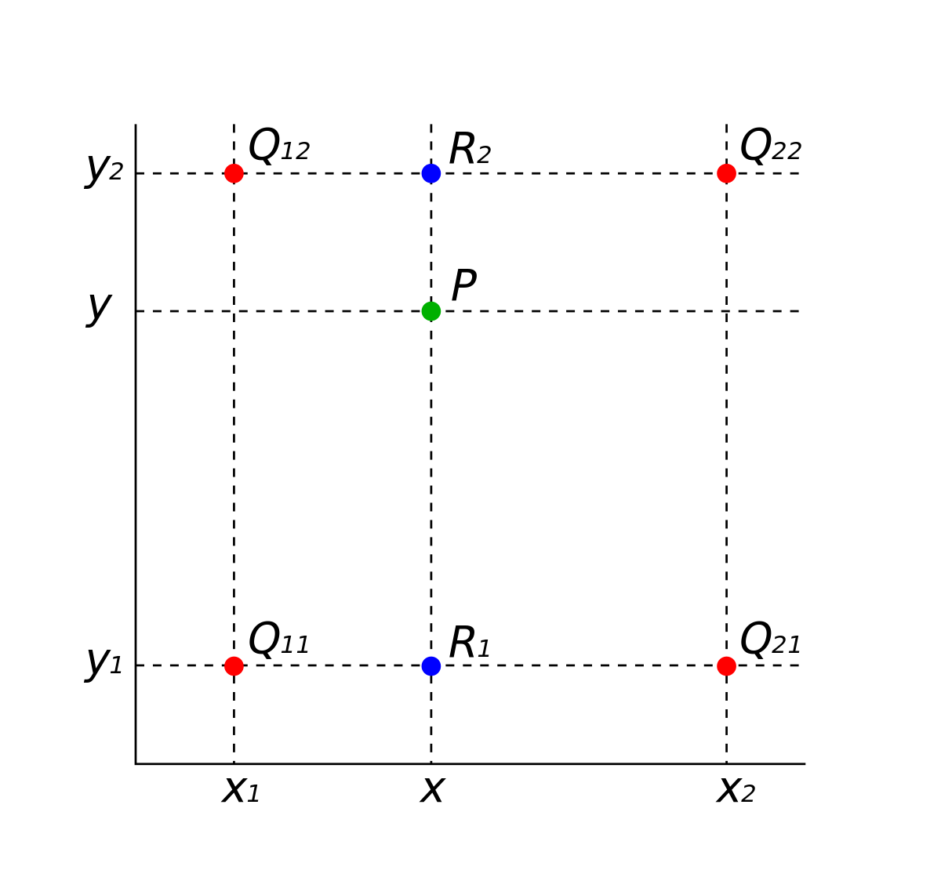
ROI-Align (Bilinear Interpolation)
Bilinear Interpolation
Q12, Q22 -> R2
Q11, Q21 -> R1
R2, R1 -> P

Slide 20
ROI Pooling
The process of RoI Pooling is to map the rectangular boxes of different sizes into rectangular boxes of fixed size (w * h);

Slide 21
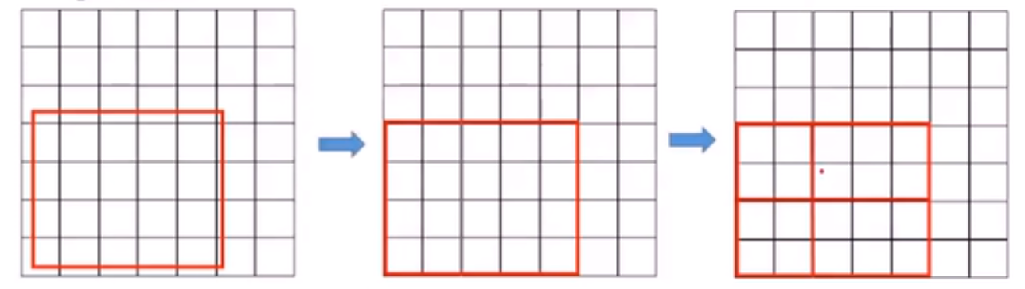
ROI Pooling Problem
These quantizations intrduce misalignments between the ROI and extracted features.
It has a large negative effect on predicting pixel-accurate masks!

Slide 22
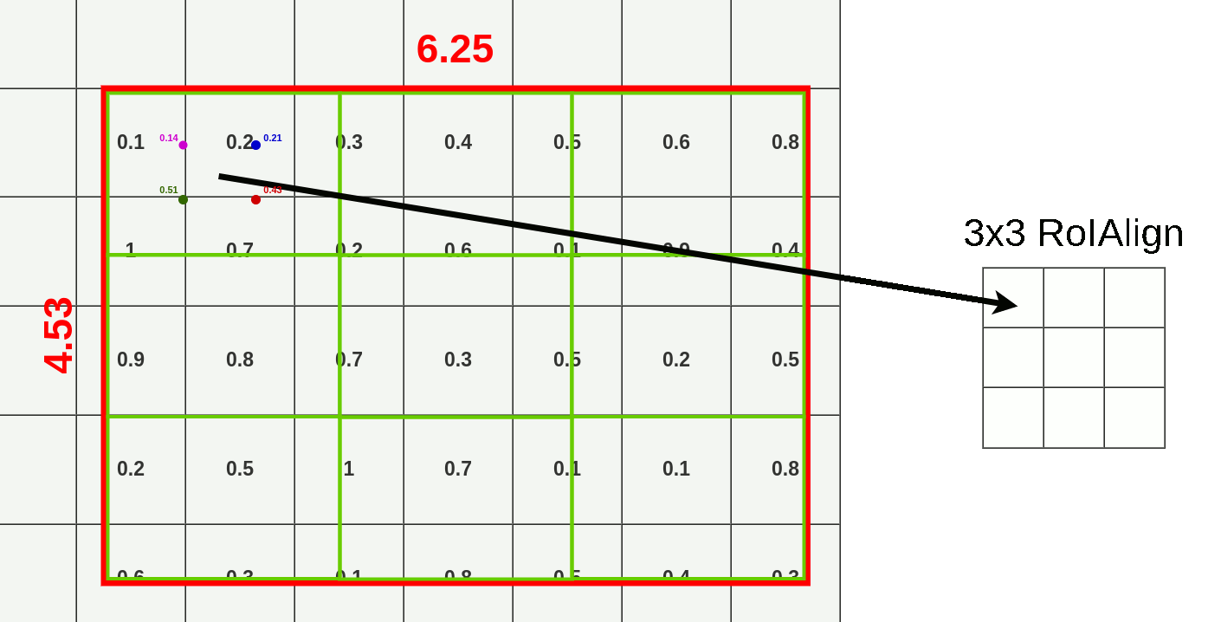
ROI-Align
Notes:
保留兩次小數，使用雙性差值

Slide 23
Summary
Instance Segmentation
ROI
ROI Pooling
RPN - Anchor
FPN
ROI Align
RCNN -> Fast RCNN -> Faster RCNN -> Mask RCNN

Slide 24
Let's start the tutorial !

